Slide 1
C#

Slide 2
Methods
A method is a block of code which only runs when it is called.
You can pass data, known as parameters, into a method.
Methods are used to perform certain actions, and they are also known as functions.
Why use methods?
To reuse code: define the code once, and use it many times.

Slide 3
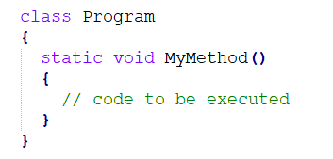
Create a Method
A method is defined with the name of the method, followed by parentheses ().
C# provides some pre-defined methods, which you already are familiar with, such as Main(), but you can also create your own methods to perform certain actions:
MyMethod() is the name of the method
static means that the method belongs to the Program class and not an object of the Program class. You will learn more about objects and how to access methods through objects later in this tutorial.
void means that this method does not have a return value. You will learn more about return values later in this chapter

Slide 4
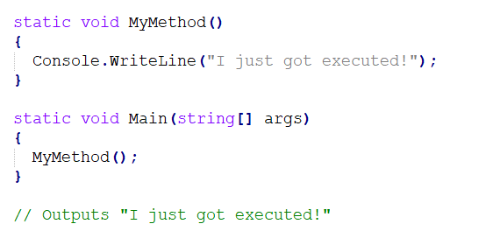
Call a Method
To call (execute) a method, write the method's name followed by two parentheses () and a semicolon ;
In the following example, MyMethod() is used to print a text (the action), when it is called:

Slide 5
Method Parameters
Parameters and Arguments
In programming, an argument is a value that is passed to a function when it is called. A parameter is the variable that receives the value of the argument inside the function.
Parameters are specified after the method name, inside the parentheses. You can add as many parameters as you want, just separate them with a comma.

Slide 6
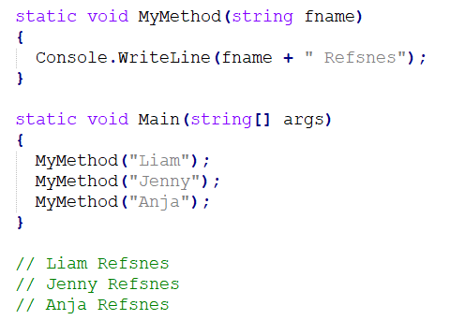
Parameters and Arguments
The following example has a method that takes a string called fname as parameter. When the method is called, we pass along a first name, which is used inside the method to print the full name:
When a parameter is passed to the method, it is called an argument. So, from the example above: fname is a parameter, while Liam, Jenny and Anja are arguments.

Slide 7
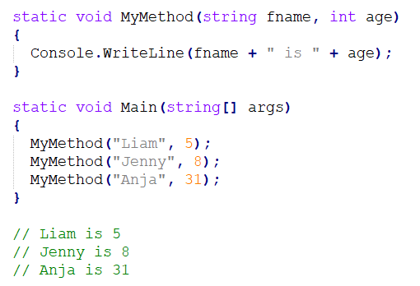
Multiple Parameters
You can have as many parameters as you like, just separate them with commas:

Slide 8
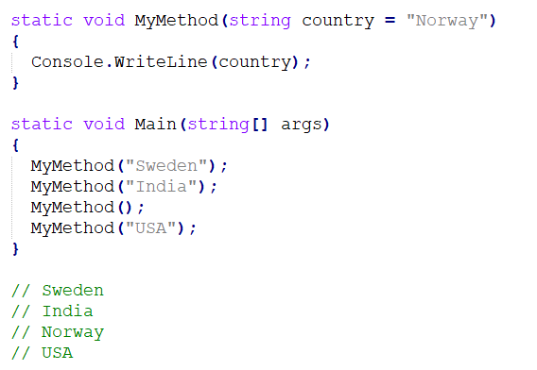
Default Parameter Value
You can also use a default parameter value, by using the equals sign (=).
If we call the method without an argument, it uses the default value ("Norway"):

Slide 9
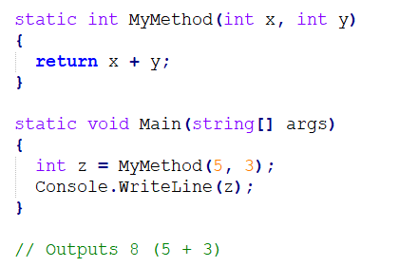
Return Values
If you want the method to return a value, you can use a primitive data type (such as int or double) instead of void, and use the return keyword inside the method:

Slide 10
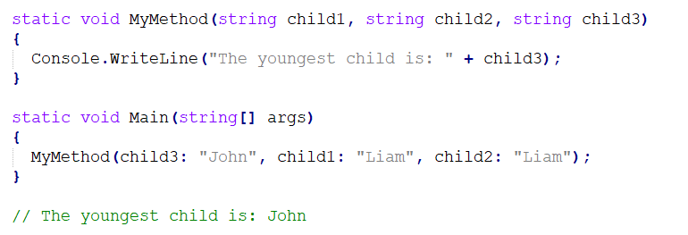
Named Arguments
It is also possible to send arguments with the key: value syntax.
That way, the order of the arguments does not matter:

Slide 11

Method Overloading
With method overloading, multiple methods can have the same name with different parameters:

Slide 12
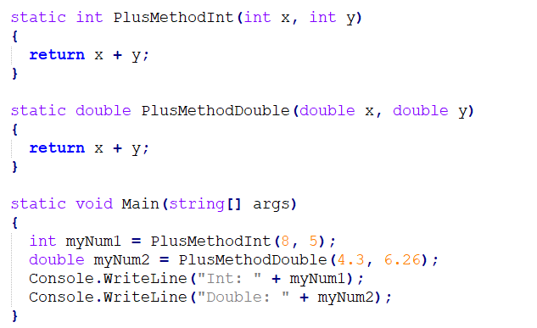
Method Overloading
Consider the following example, which have two methods that add numbers of different type:

Slide 13
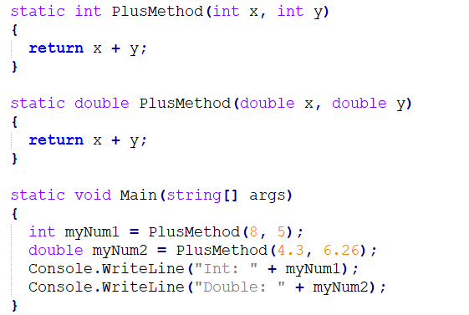
Method Overloading
Instead of defining two methods that should do the same thing, it is better to overload one.
In the example below, we overload the PlusMethod method to work for both int and double:

